Slide 1
Examples from previous years

Slide 2
Intervention research in child development has repeatedly produced a paradoxical conclusion: In correlational studies, parental assistance with children’s homework has been associated with lower academic achievement. As a result, some psychologists have concluded in published reports that parents should not help their children with homework…

Slide 3
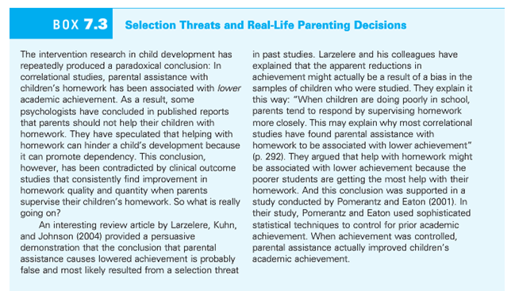

Slide 4
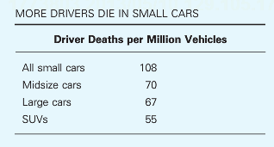
Multiple accounts consistent with the data
Large cars are safer than small cars
Small cars are more dangerous than large cars
Safest cars: Acura RX SUV, Acura RL sedan, Audi 4
Most dangerous cars: Chevy Cobalt, Ford Focus, Mazda 3

Slide 5
Niedenthal & Setterlund (1994) hypothesized that emotions influence perception, that is, our feelings influence the way we see the world. The researchers used music to induce either a happy or sad mood. “Eine Kleine Nachtmusik” by Mozart was used to put one group of subjects in a happy mood. “Adagio for Strings” by Barber was used to put another group of participants in a sad mood. After listening to the music, each participant’s mood was assessed to verify the effectiveness of the mood manipulation. Participants were then given a “lexical decision” task in which they were shown words or non-words (e.g., bragzap, crumdip). Amongst the words shown were 6 happy-related words: delight, cheer, joy, humor, harmony, comedy; and 6 sad-related words: weep despair, regret, hurt, frown, defeat. An interaction between group and word type was found that supported the hypothesis of the researchers that words congruent to mood would be identified more rapidly.

Slide 6
Hypothetical Data 1
What effects?
Main effects?
Interaction?

Slide 7
Hypothetical Data 2
What effects?
Main effects?
Interaction?

Slide 8
Wason Card Task
A
D
4
7
Hypothesis: If a card has a vowel on one side, then it has an even number on the other side.
Which cards do you turn over?

Slide 9
The Bar Bouncer task
Soda
Beer
16
22
Hypothesis: If a person is drinking beer, they must be 21 years or older…
Which cards do you turn over?

Slide 10
Selection threat: Homework
The intervention research in child development has repeated produced a paradoxical conclusion: in correlational studies, parental assistance with children’s homework has been associated with lower academic achievement. As a result, some psychologists have concluded in published reports that parents should not help their children with homework. They have speculated that helping with homework can hinder a child’s development because it can promote dependency. This conclusion, however, has been contradicted by clinical outcome studies that consistently find improvement in homework quality and quantity when parents supervise their children’s homework…

Slide 12
Sugar and hyperactivity in children
“Sugar rush”: candy, cake, etc., leads to high-activity behavior in children
Why do many people think this is true?
What is the role of experimental versus non-experimental data in this common belief?

Slide 13

Experimental Research on Sugar
How would we design a study to refute this idea?
What is the fundamental problem with our experimental approach?

Slide 14
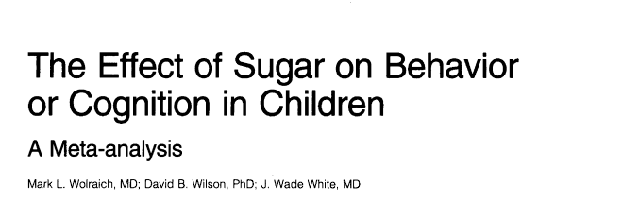
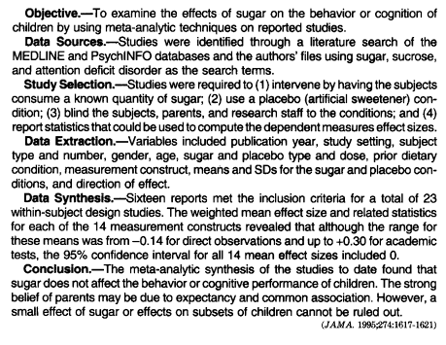
Meta-analysis: combined re-analysis of a set of published research studies
Provides additional sensitivity to small effect sizes
Can be used to argue for effect size = 0

Slide 15
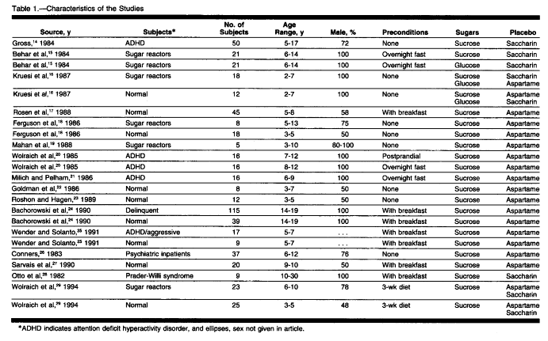

Slide 16
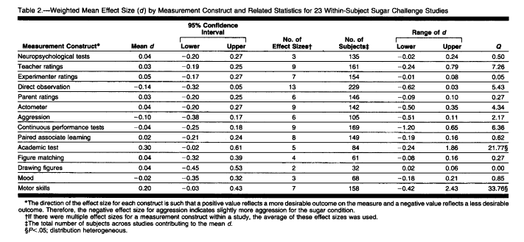

Slide 17
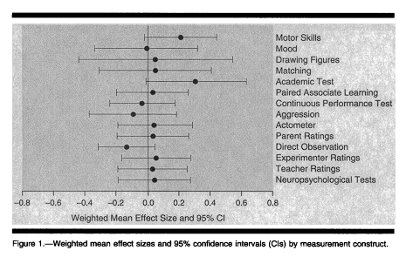
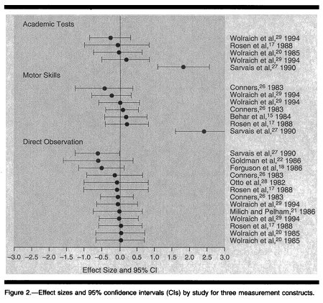
Forest Plots

Slide 18
Sugar and hyperactivity in children
“Sugar rush”: candy, cake, etc., leads to high-activity behavior in children
Why do many people think this is true?
What is the role of experimental versus non-experimental data in this common belief?

Slide 19
Experimental Research on Sugar
How would we design a study to refute this idea?
What is the fundamental problem with our experimental approach?

Slide 20
Meta-analysis: combined re-analysis of a set of published research studies
Provides additional sensitivity to small effect sizes
Can be used to argue for effect size = 0

Slide 23
Forest Plots

Slide 24
Brain Training
Jaeggi et al. (2008) reported an intervention that appeared to increase fluid intelligence
Basic science: fluid intelligence is supposed to be immutable
Some core cognitive abilities are traits
Unaffected by education, experience, environment
Applied science: “use it or lose it” in cognitive aging
Lifetime cognitive engagement predicts better aging
High levels of education, “occupational complexity”

Slide 25
Methodological challenges
What is the best control condition to the intervention?
Demand characteristics matter
What is the appropriate dependent variable?
Matrix-based IQ tests are not designed for this
Generalization across age
Undergraduates
Children
Older adults
Effect size estimates
0.8 -> 0.2

Slide 26
RCR Problems
Lumosity Brain Training company
Licensed tasks
Funded efficacy research
Paid a large fine for misleading advertising
Brain training markets
Children with learning disabilities
Older adults and cognitive decline
Conflict of Interest concerns greatly heightened skepticism

Slide 27
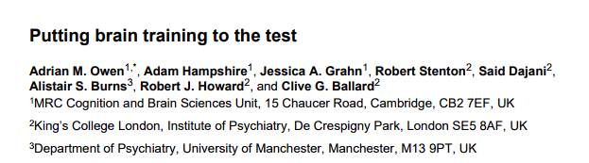
Owen et al. (2010)
Large-scale study failed to find effects
6 weeks of training
N = 11,430 online participants
Practice improved performance on trained tasks
Did not transfer to any general or untrained measures
Similar to many other training studies with null findings

Slide 28

Corbett et al. (2015)
Adults > 60
N = 2912
Reasoning based cognitive training improved performance on reasoning, working memory and verbal learning
Effect size 0.15 – 0.20 for ADL, VL
Effect size 0.30 for Reasoning tasks

Slide 29
Childhood Developmental Studies
More mixed results and RCR issues
“Fast ForWord” result unable to be replicated, but still sold popularly
Auditory training of phonemes to improve reading
Interventions with LD children appear effective
Difficult to control maturation effects
Cognitive functions being trained improve with age, education
Smaller n’s in most studies

Slide 30
Brain Training Summary
Does “brain training” work?
Who’s asking?
Yes, for some populations and some outcomes
Illustrates many challenges of intervention research
What is the intended population and how are they sampled?
What is the dependent variable outcome measure?
How is the control task implemented?
How rigorous is the methodology?

